Slide 1
Performance Management
Image from CAS Interiors Inc.
Employee/Employer Assessment
Presented by:
Samena Brinkman, Tori Cameron, Celissa Nardocci, Rutvi Shah
Image from CAS Interiors Inc.
Notes:
Tori

Slide 2
Agenda
Employer Information
Questions for CAS
About the Employee
Competency Model
Bars Chart
Competency Assessment Report
Image from CAS Interiors Inc.
Notes:
Tori

Slide 3
Employer Information
Vice President : Lorraine Apanashk
Been with CAS for 15 years
Candidates received from Harbinger Network
Conducts interview for office staff
Conducts secondary interviews for site level roles
Image from CAS Interiors Inc.
Notes:
Tori

Slide 4
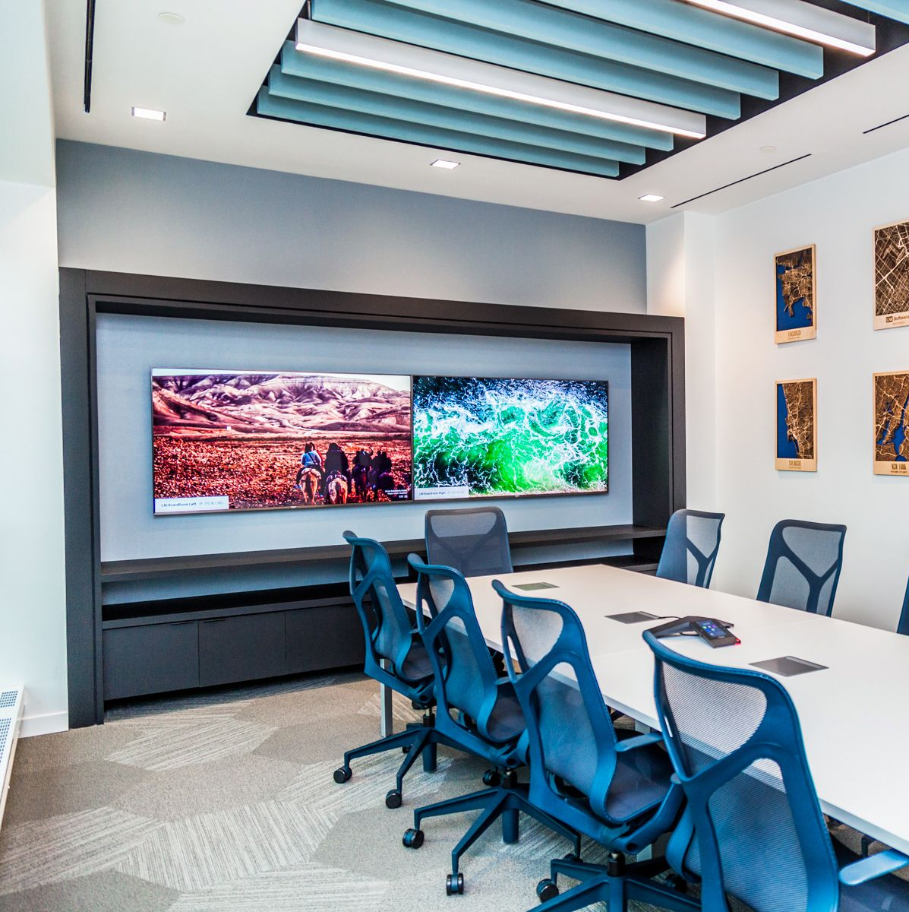
Questions for CAS Interiors Inc.
How long has the employee being assessed been with CAS?
Reasons for hiring the employee being assessed for the Project Coordinator role
What is your role, Lorraine, in the hiring process?
Of the competencies we have listed, have we accurately marked which ones would fall under a trainable behaviour or a must have upon hiring?
How long has the employee being assessed worked in the Project Coordinator role?
Image from CAS Interiors Inc.
Image from CAS Interiors Inc.
Notes:
Tori to present

Slide 5
About the Employee
Employed by CAS since 2017
Project Coordinator since 2017
Hiring Reasons:
Good fit for company culture and environment
Industry knowledge and experience
High attention to detail
Positive personality
Excellent communication skills
Image from CAS Interiors Inc.
Notes:
Tori to Present

Slide 6
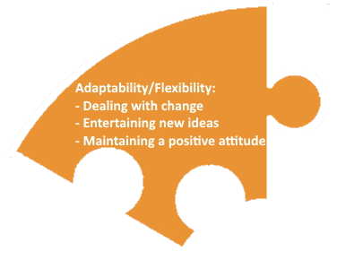
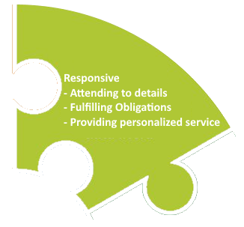
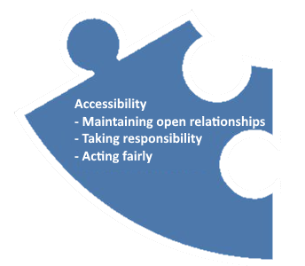
CAS Interiors Core Values
Competency Model
Adaptability/Flexibility
Displaying the capability to adapt to new, different or changing requirements.
Accessibility
Responsive
Inspired
Motivated to act on creative and mental connections and impulses
Readily and sympathetically acting on appeals, efforts and influences
Being approachable, available and easy to talk to by acting fairly and taking responsibility for one’s actions.
Notes:
Sam to present

Slide 7
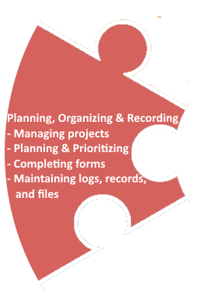
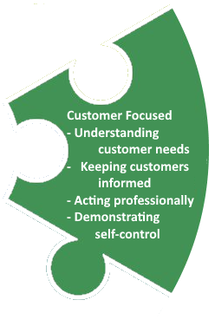
Putting the Puzzle Together
Competency Model
Customer Focused
Efficiently and effectively addressing the needs of clients/customers.
Planning, Organizing and Recording
Planning, recording, storing, and maintaining information in written or electronic/digital format to prioritize work and manage time effectively.
Notes:
Sam to Present

Slide 8
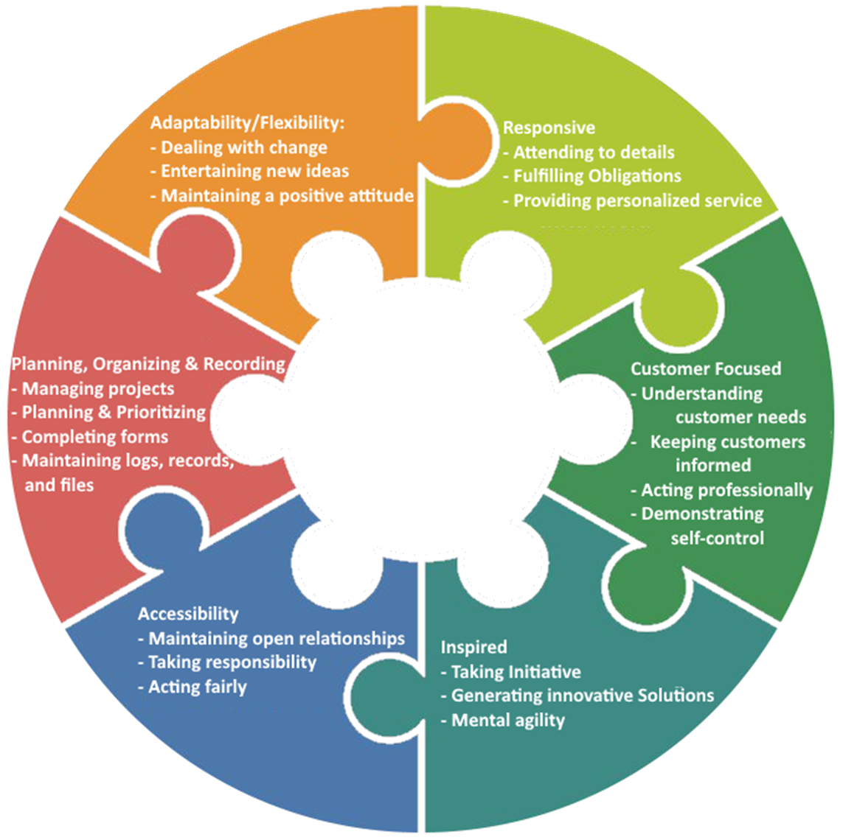
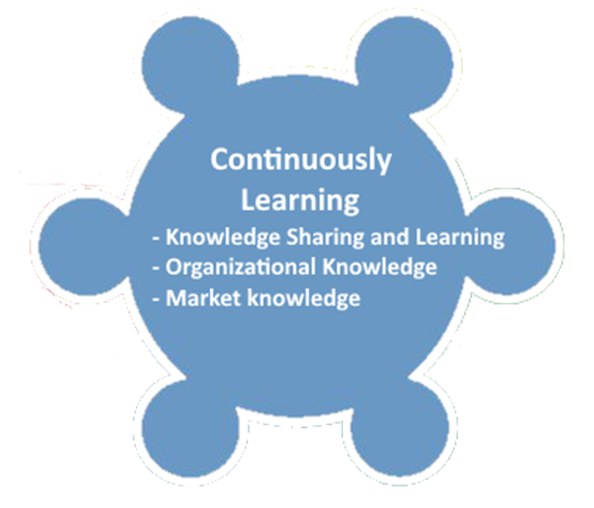
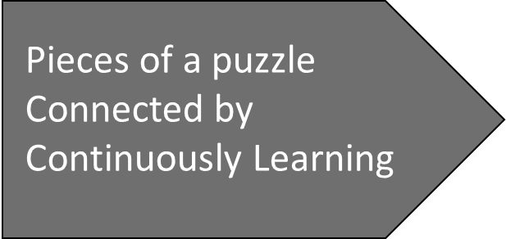
Continuously Learning The constant expansion of skills and knowledge through learning and development.
Competency Model
Notes:
Sam to Present

Slide 9
Behaviorally Anchored Rating Scales (BARS):
Accessibility:
Being approachable, available and easy to talk to by acting fairly and taking responsibility for one’s actions
5
Always and Is an example
to or could train others
4
Consistently
The employee consistently maintains open lines of communication with others. Normally encourages others to share problems and successes, and easily builds trust and rapport with the internal and external stakeholders.
3
Often and is Improving
The employee often maintains open lines of communication with others. Usually encourages others to share problems and successes and builds trust and rapport with the internal and external stakeholders.
2
Seldom and Needs Coaching
The employee seldom maintains open lines of communication with other. Occasionally encourages others to share problems and successes and has difficult in building trust and rapport with the internal and external stakeholders.
1
Unaware or Uninterested
or Refuses
The employee always maintains open lines of communication with others. At all times encourages others to share problems and successes, and easily builds trust and rapport with the internal and external stakeholders. .
The employee never maintains open lines of communication with others, does not encourage others to share problems and successes, and does not build trust and rapport with the internal and external stakeholders.
Maintaining Open Relationships
Notes:
Celissa to present

Slide 10
5
Always and Is an example
to or could train others
4
Consistently
The employee consistently takes responsibility and accomplishes work goals within accepted timeframes. They consistently take initiative to communicate the appropriate information through the appropriate channels and is able to make quick confident decisions to prioritize and organize competing tasks.
2
Seldom and Needs Coaching
1
Unaware or Uninterested
or Refuses
3
Often and is Improving
The employee always takes responsibility and accomplishes work goals within accepted timeframes. They always take initiative to communicate the appropriate information through the appropriate channels and is able to make quick confident decisions to prioritize and organize competing tasks.
The employee often takes responsibility and accomplishes work goals within accepted timeframes. They often take initiative to communicate the appropriate information through the appropriate channels and is able to make quick confident decisions to prioritize and organize competing tasks.
The employee seldom takes responsibility and does not always accomplishing work goals within accepted timeframes. They occasionally take initiative to communicate the appropriate information through the appropriate channels and has difficult in making quick confident decisions to prioritize and organize competing tasks.
The employee never takes responsibility for not accomplishing work goals within accepted timeframes. They seldomly communicate the appropriate information through the appropriate channels and is not able to make quick confident decisions to prioritize and organize competing tasks.
Taking Responsibility
Notes:
Celissa to present

Slide 11
5
Always and Is an example
to or could train others
4
Consistently
The employee consistently takes responsibility and accomplishes work goals within accepted timeframes. They consistently take initiative to communicate the appropriate information through the appropriate channels and is able to make quick confident decisions to prioritize and organize competing tasks.
2
Seldom and Needs Coaching
1
Unaware or Uninterested
or Refuses
3
Often and is Improving
The employee always takes responsibility and accomplishes work goals within accepted timeframes. They always take initiative to communicate the appropriate information through the appropriate channels and is able to make quick confident decisions to prioritize and organize competing tasks.
The employee seldom takes responsibility and does not always accomplishing work goals within accepted timeframes. They occasionally take initiative to communicate the appropriate information through the appropriate channels and has difficult in making quick confident decisions to prioritize and organize competing tasks.
The employee often takes responsibility and accomplishes work goals within accepted timeframes. They often take initiative to communicate the appropriate information through the appropriate channels and is able to make quick confident decisions to prioritize and organize competing tasks.
The employee never takes responsibility for not accomplishing work goals within accepted timeframes. They seldomly communicate the appropriate information through the appropriate channels and is not able to make quick confident decisions to prioritize and organize competing tasks.
Acting Fairly
Notes:
Celissa to present

Slide 12
Competency Gap
Competency Gaps are the gaps between employer's expectations and the level to which the employee is performing.
The gaps for this employee were either equal to 0 or exceeded by +1 or +2
There were no negative gaps
For instance, the adaptability/flexibility competency had the organization expectation of 4, but the competency level of the employee is 5.
Image from CAS Interiors Inc.​

Slide 13
Project Coordinator Competency Assessment

Slide 14
Competencies Required at Job Start
Some of the examples of required competencies are:
Dealing with change – completes and prioritizes daily checklist based on urgency
Acting fairly- Treat others with honesty, fairness and respect.
Fulfilling Obligations- Diligently follow through on commitments and consistently complete assignments by deadlines
Keeping Customers Informed-Follow up with customers during projects and following project completion
Image from CAS Interiors Inc.​

Slide 15
Competencies that can be Trained on the Job
Following are trainable competencies :
Entertaining New Ideas- Actively seeks out and carefully considers the merits of new approaches
Taking Responsibility-Able to make quick confident decisions to prioritize and organize competing tasks
Taking initiative:- Go beyond the routine demands of the job to increase its variety and scope.
Attending to Details- Notice errors or inconsistences and take prompt, thorough action to correct
Image from CAS Interiors Inc.​

Slide 16
Questions?
Image from CAS Interiors Inc.​

